Slide 1
Hypothesis Testing

Slide 2
Till now we have learned about descriptive statistics, in which we are finding put different values from given dataset.
In Inferential statistics, we are figuring out something regarding population from given sample data.
In hypothesis testing we are forming a hypothesis
Hypo means hypothetically and thesis means something research thing and factually proven.
Hypothesis is something, we are assuming.
Goal of hypothesis testing is to either prove something or reject statistics
Like average voting in 2024 is 64%. So through hypothesis you are proving it or rejecting it.
The sentence you are preparing for hypothesis testing is really important
Like Mumbai indians will score more than 60 runs in first 10 overs.
My goal will be either prove this thing or reject this thing. For that we are using statistics techniques

Slide 3
Whatever outcome I am giving is basis on probability. Probability help us to put threshold or cut off.
So we can set a initial probability and that is called significance level.
Significance level can be taken as 0.05
If I can able to statistically prove either score is > 60 or <60 and find the probability on this
Based on this probability, I will compare this with cut off probability
If it’s above the cut of probability then my answer is Yes means approve and if not then No means rejection
This is basic hypothesis testing

Slide 4
Eg, I am preparing for government exam from last five years and this time giving 6th attempt. In last five years got a marks of 70, 64, 51, 82, 72
Now I will form a hypothesis and general statement is government decide that cut off for the exam will be >60 and will move to the next step.
So my hypothesis will be in my 6th attempt I will get the marks more than 60
Null Hypothesis:- it means that the condition already there or given in that
In this case, H0 = My marks equal to 60
Alternate hypothesis:- the condition that we want to happen
In this case, H1 = Marks > 60

Slide 5
After deciding null hypothesis and alternate hypothesis, we will do statistical analysis to find the probability of Marks = 60 consider as a P1
Now will compare P1 value to significant value or Alpha value. If alpha is not given then value will be 0.05
The 0.05 value is a widely used convention, meaning there's a 5% chance of incorrectly rejecting the null hypothesis.
If P1 > Alpha that means that means that we have enough evidence of sample data saying that your marks will be 60
If P1 < Alpha means you will reject the null hypothesis and will go to the alternate hypothesis (Marks would be > 60)
If marks is < 60 then we are going for tail test and defining the null hypothesis

Slide 6
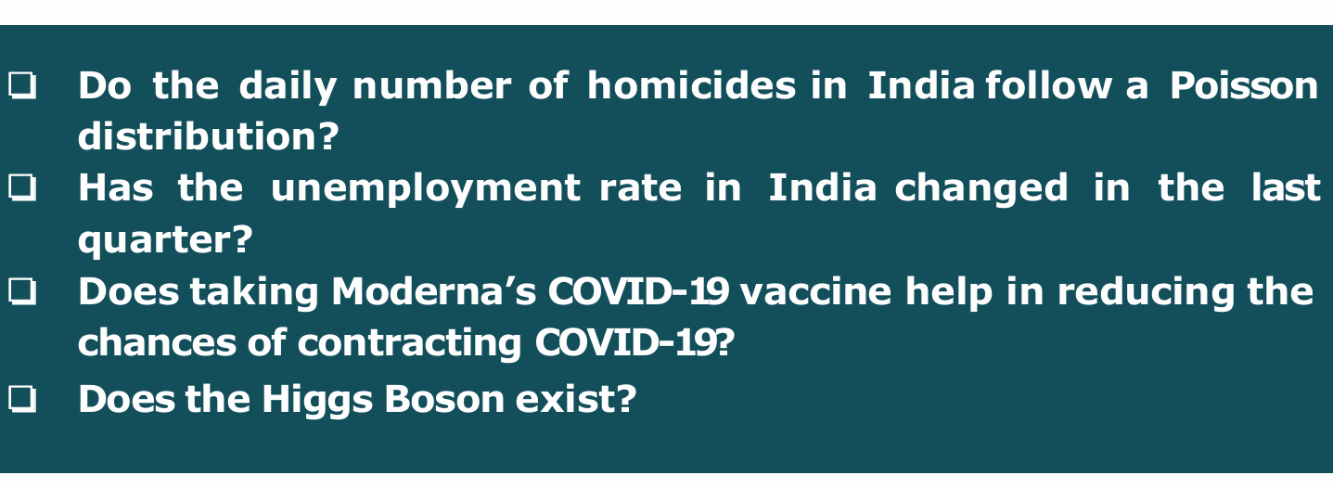
Example
Below are all types of questions which we can not quantify. These are just vague statement, no numbers in that

Slide 7
On some parameter, we have to quantify the statement and then make the hypothesis
We convert those questions to statement in which numbers involved. So we can do something with number.

Slide 8
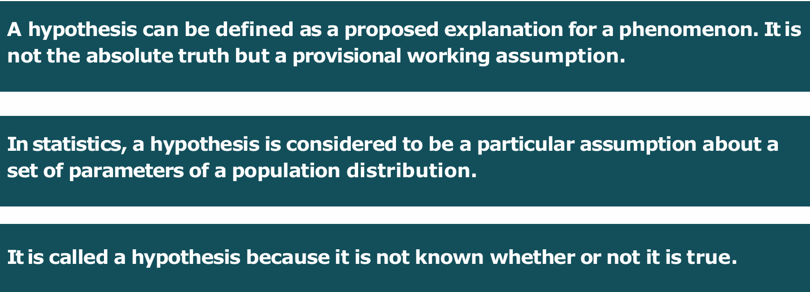
What is Hypothesis

Slide 9
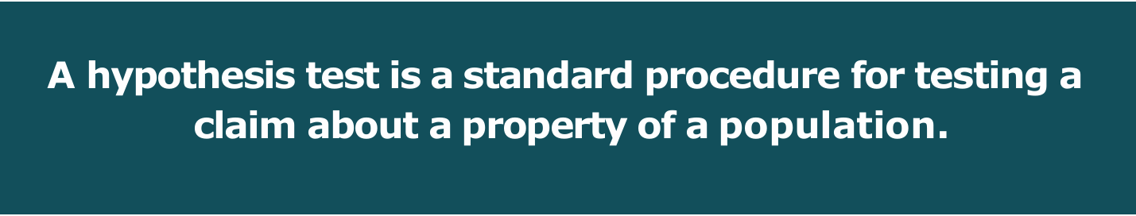
What is Hypothesis Test?

Slide 10
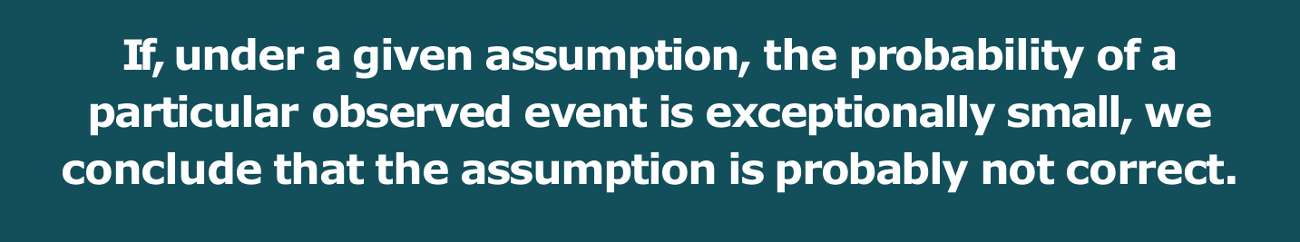
Rare Event Rule for Inferential Statistics
In Hypothesis we are not finding the probability, we are finding the probability of null value
The approach is find the probability and compare with significance level of probability
Alpha of 0.05 give you the 95% significant means whatever we are doing is 95% significant
If particular event has very low chance of happening then it’s quite extreme event and we will reject that event.
Our extreme event will always alternate hypothesis

Slide 11
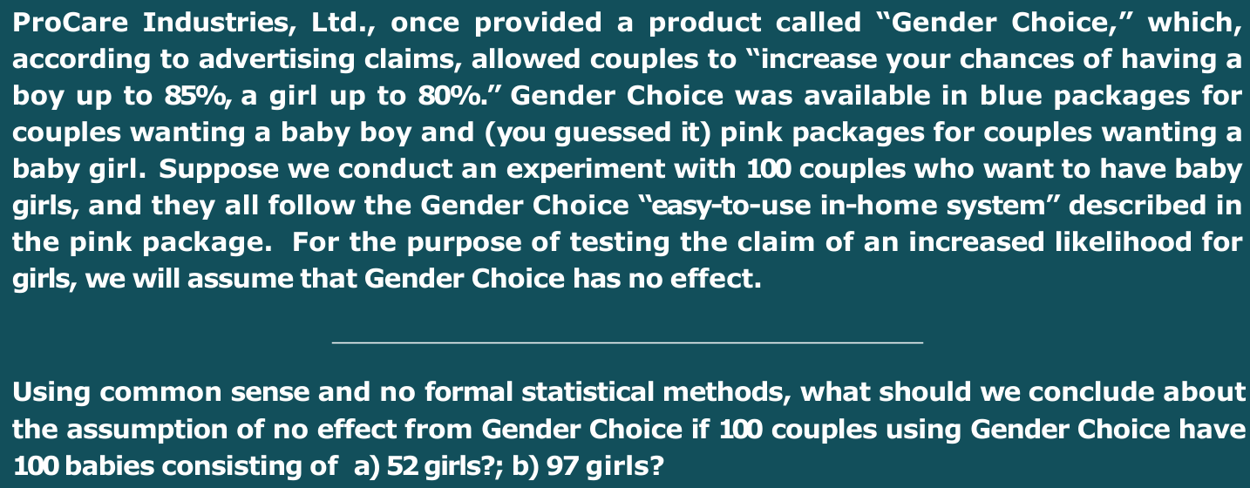
Example

Slide 12
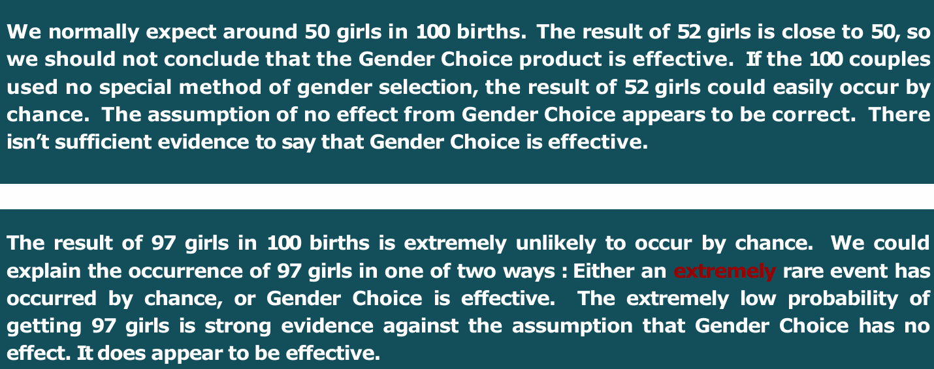

Slide 13
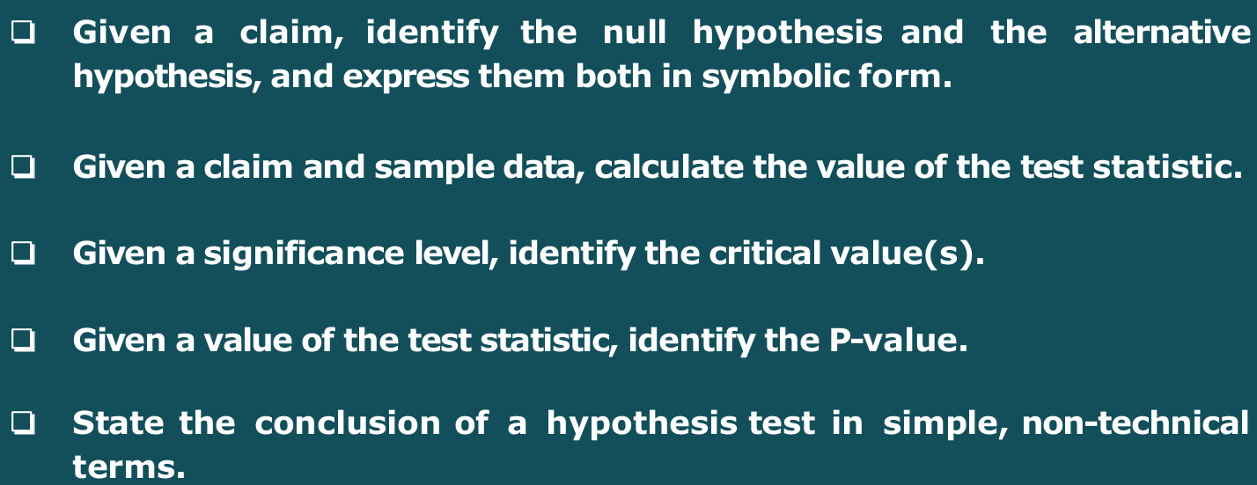
Component of a formal Hypothesis Test

Slide 14
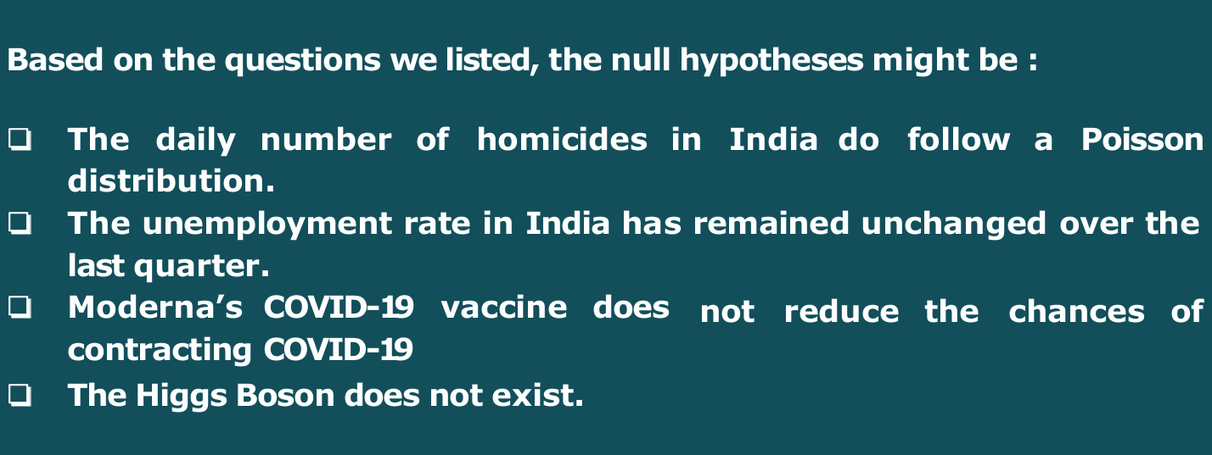
Null Hypothesis H0
A null hypothesis is a hypothesis that says there is no statistical significance between the two variables.
Below are the example of null hypothesis. Like original statement is Does the higgs boson exist?
Whatever your question is whether this happen is consider that thing as a fact and that becomes your null hypothesis.

Slide 15
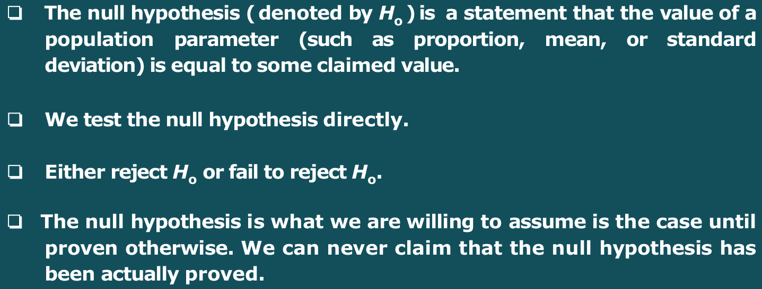

Slide 16
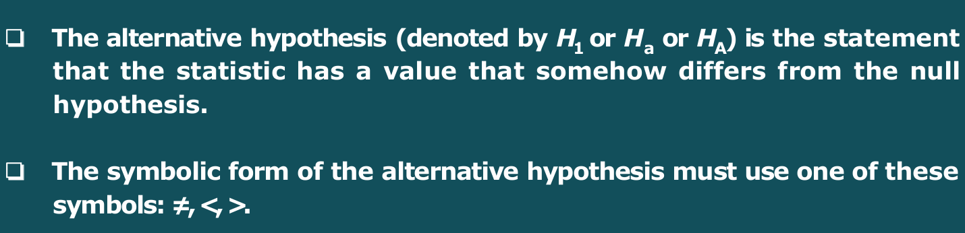
Alternate Hypothesis
Whatever you want to prove is your alternate hypothesis

Slide 17
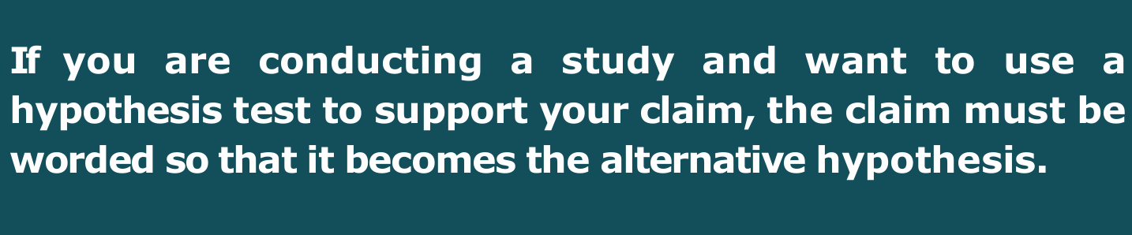
How to form your claim or Hypothesis

Slide 18
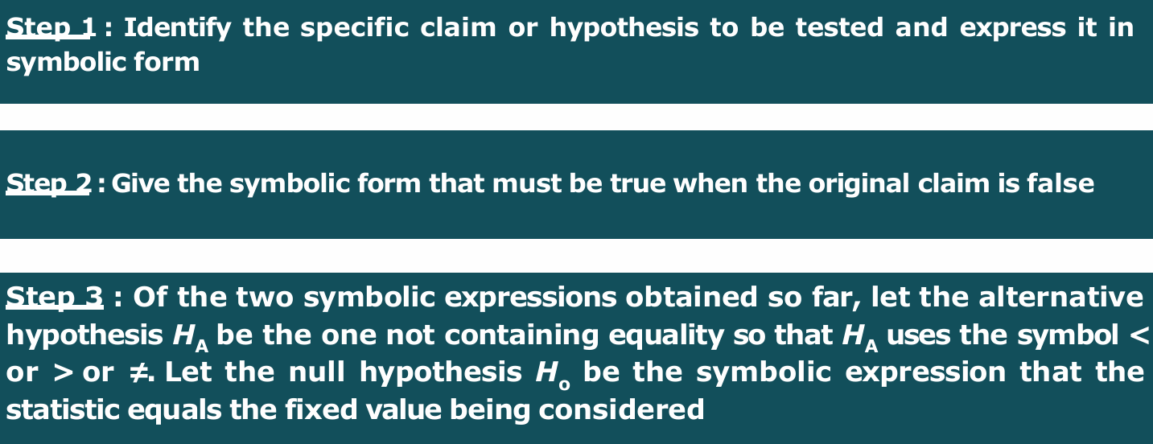

Slide 19
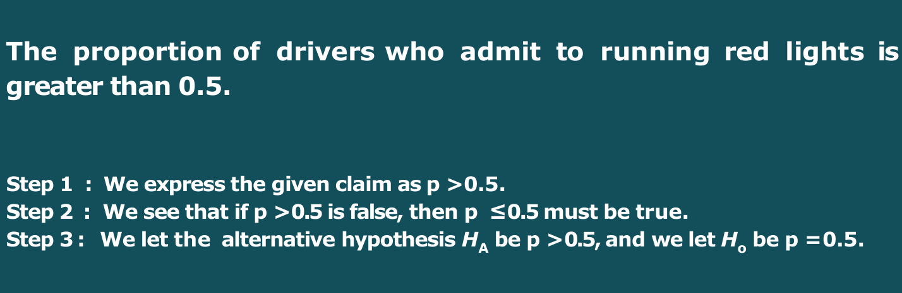
Identify the Null and Alternate Hypothesis

Slide 20
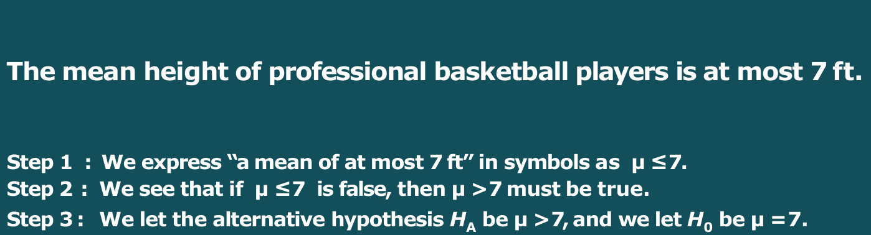
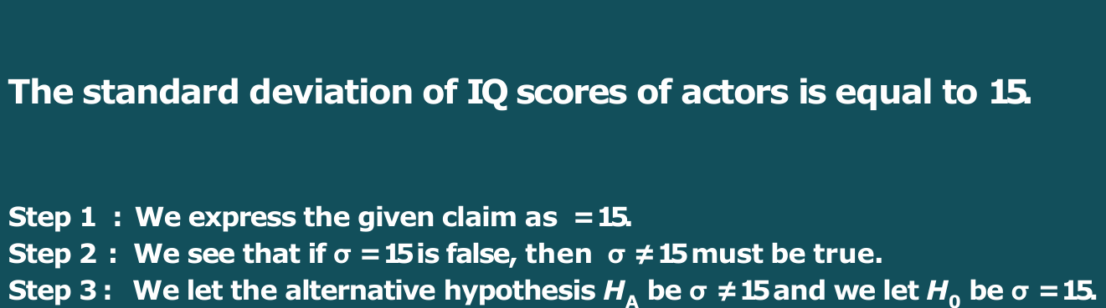
Example

Slide 21
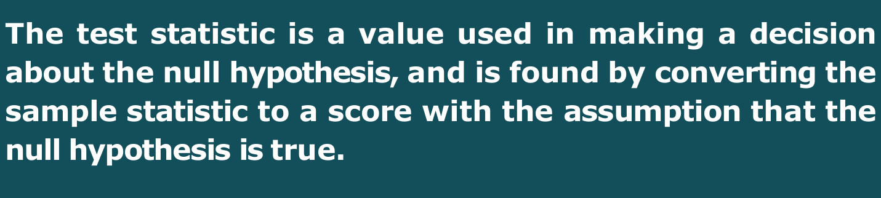
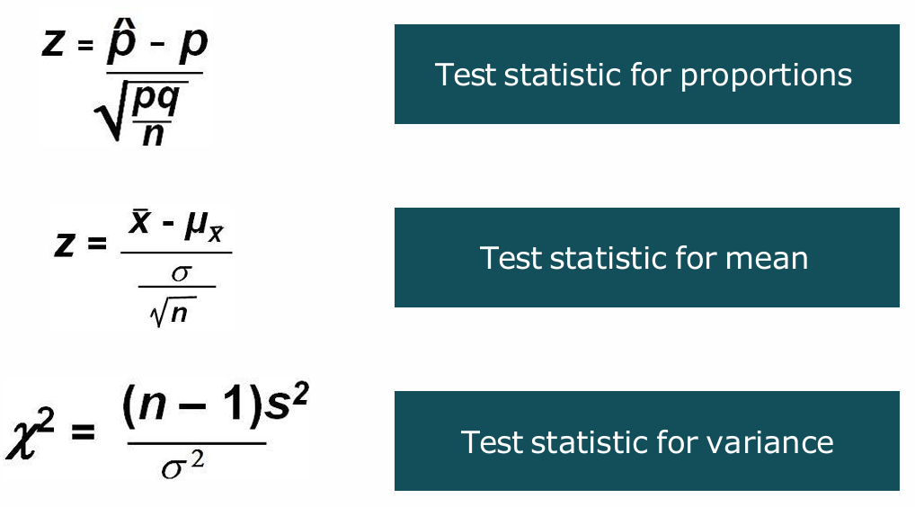
Test Statistics - Formula

Slide 22
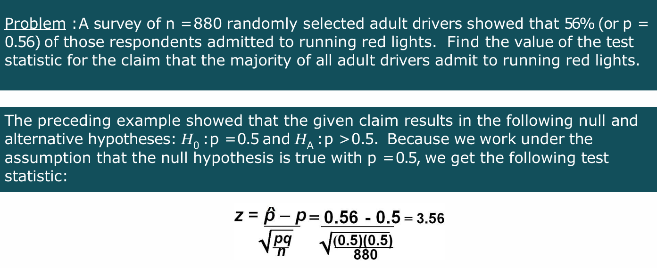
Example

Slide 23

Significance Level

Slide 24

Critical Region
When your values fall under rejection area, then there is very low probability of occurring
So we are rejecting the null hypothesis and going with the alternate hypothesis

Slide 25

Critical Value

Slide 26
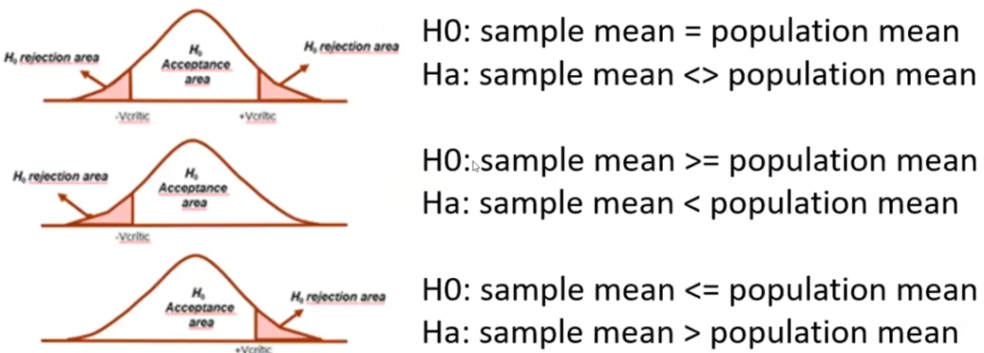
Two tailed, Right tailed and left tailed

Slide 27
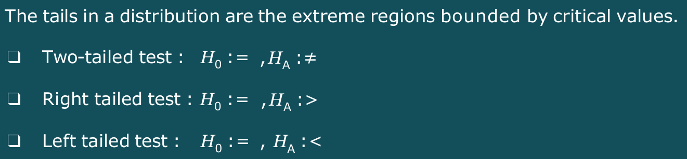

Slide 28
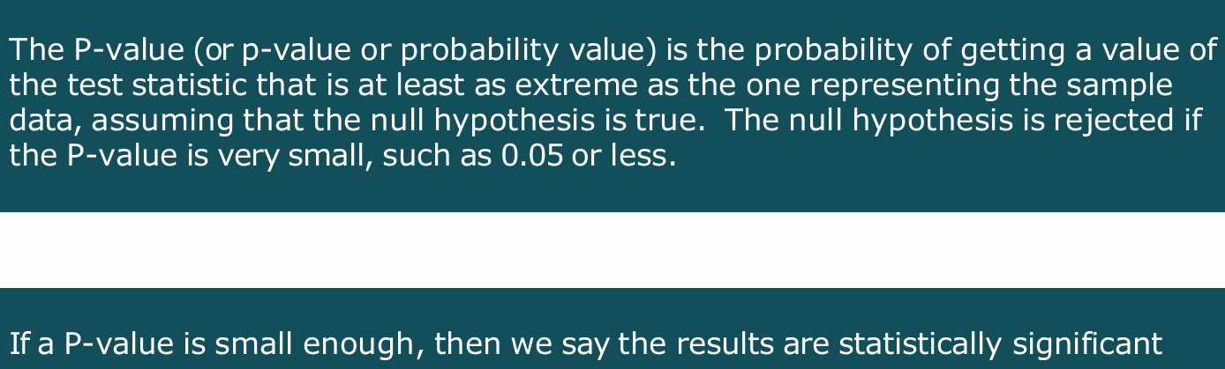
P - Value

Slide 29
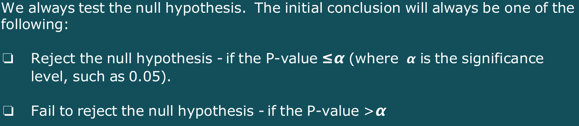
Conclusion in Hypothesis Testing based on P - Value

Slide 30
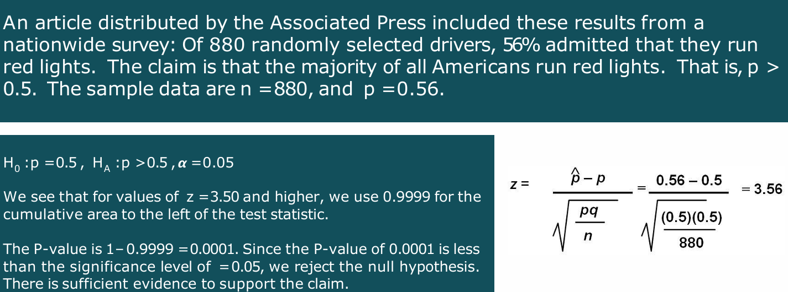
Example

Slide 31
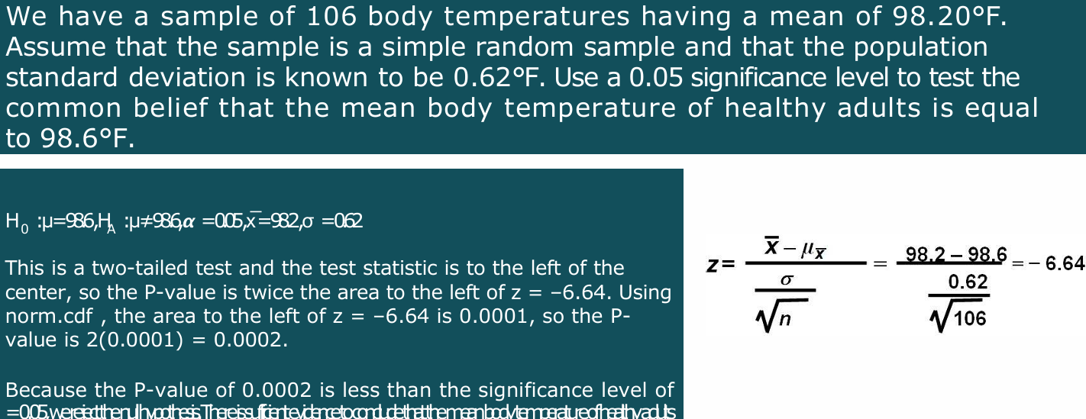
Example

Slide 32

Type – 1 Error

Slide 33
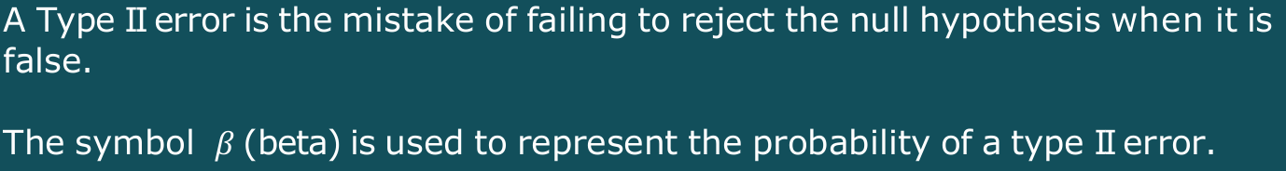
Type 2 Error

Slide 34
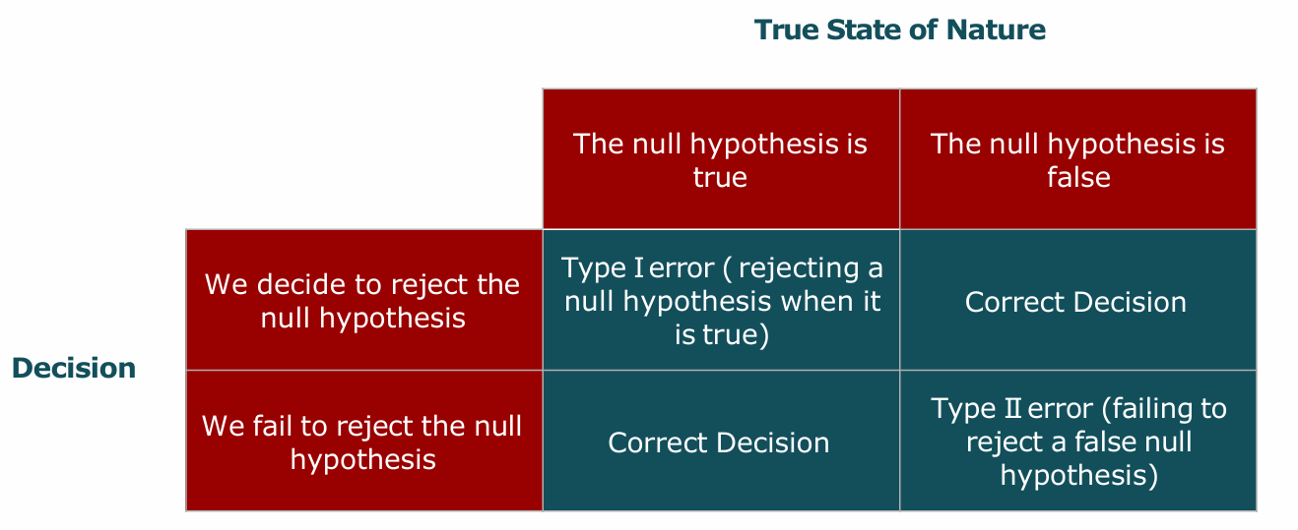
Confusion Matrix

Slide 35
A/B Testing
Nothing but fancy name of hypothesis testing or more industry oriented name for hypothesis testing
Whatever hypothesis you have, means if you have two production line A & B and both of have same efficiency 80%
Now R&D team wanted to improve the process in B production line
Means you are not changing anything in A and you making improvement in B
So now your Null Hypothesis is Pa = Pb and your alternate hypothesis is Pa < Pb (because in belt B we are making changes or we are doing some treatment or doing testing)
In A / B testing A is our control group (Like Production Line A) and B is your treatment group or experiment group

